Slide 1
FDS 1주차
2021-04-26
백주엽

Slide 2
Possible ways
1. Anomaly detection
2. Binary classification (with up-sampling method)
+) graph model

Slide 3
Review of anomaly model

Slide 4
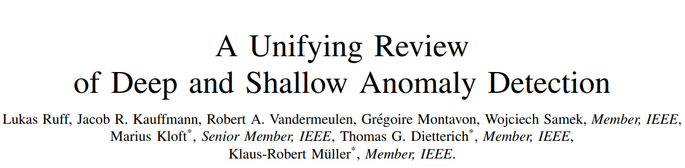
Anomaly based

Slide 5
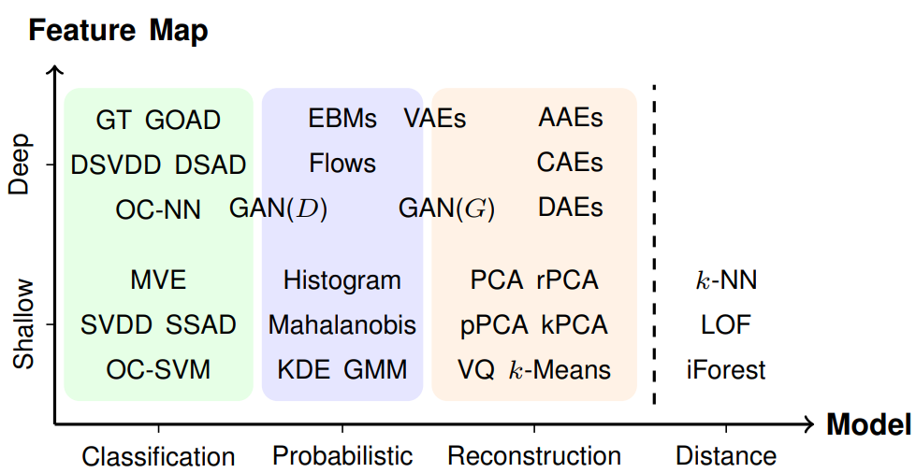
Anomaly based
Types of AD
Which one is the best??
(장담x)

Slide 6
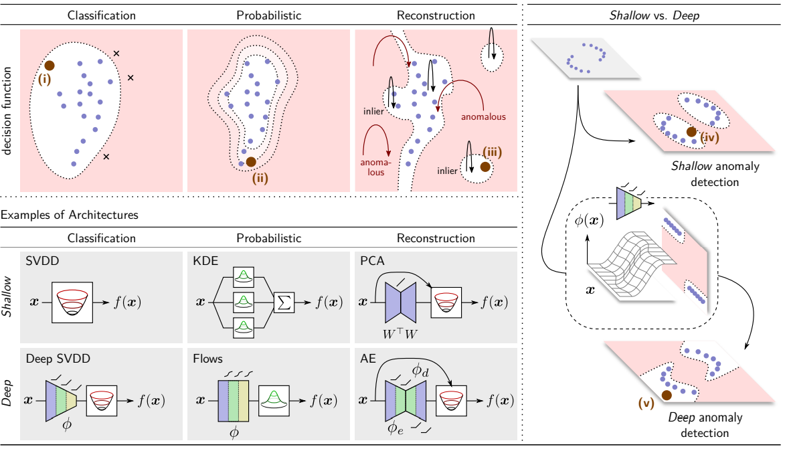
Anomaly based
Failure Detection

Slide 7
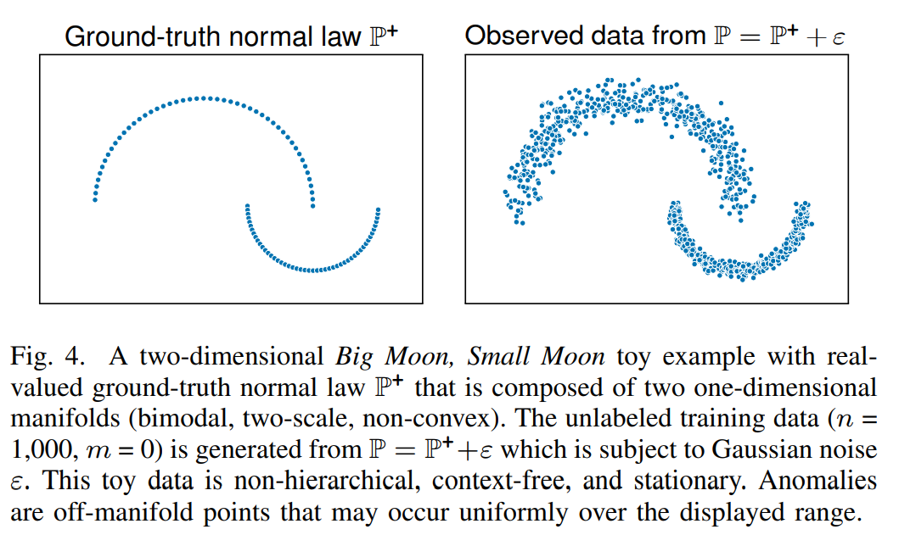
Anomaly based
Full moon, small moon toy data
anomaly

Slide 8
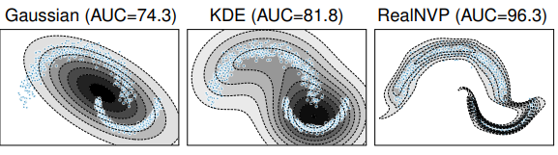
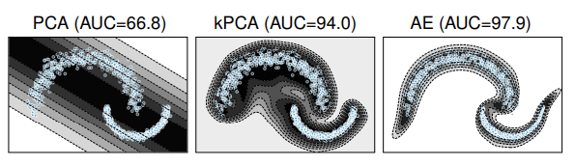
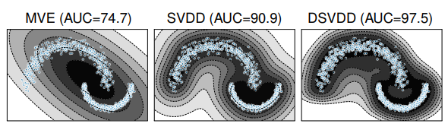
Anomaly based
Result (참고용)
세가지 방식 모두 NN 기반(deep)이 좋은 성능 보임

Slide 9
Classification model

Slide 10
Anomaly based
Classification models
One class SVM (or SVDD) with feature selected by human
Deep SVDD
One class Neural Net
Shallow
Deep

Slide 11
Anomaly based
One class SVM (or SVDD) with feature selected by human
X : 720 features
(only normal cases)
label : no need
Selected 42 features
OC SVM(or SVDD)
score

Slide 12
Anomaly based
Deep SVDD
X : 720 features
(only normal cases)
label : no need
Embedded features
(by NN)
OC SVM(or SVDD)
score
Jointly trained
PyTorch Implementation
-https://github.com/lukasruff/Deep-SVDD-PyTorch

Slide 13
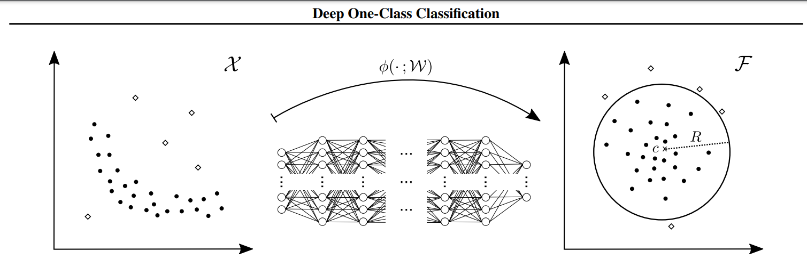
Anomaly based
Deep SVDD
결정 경계를 찾기 수월한 Latent space로 mapping 해주는 함수를 NN 이용하여 찾는다

Slide 14
Anomaly based
One class Neural Net
X : 720 features
(only normal cases)
label : no need
Neural Net
(Encoder + feed forward network)
score

Slide 15
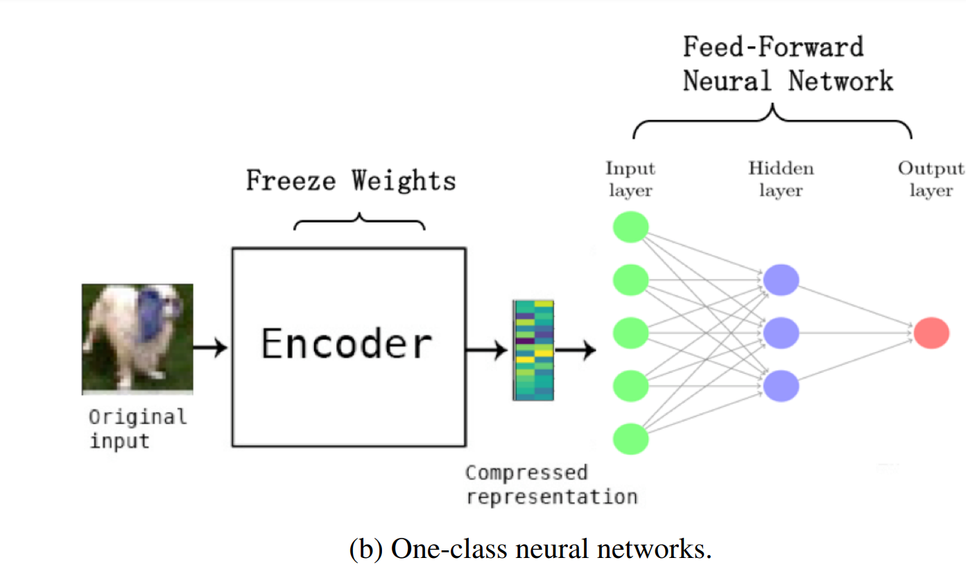
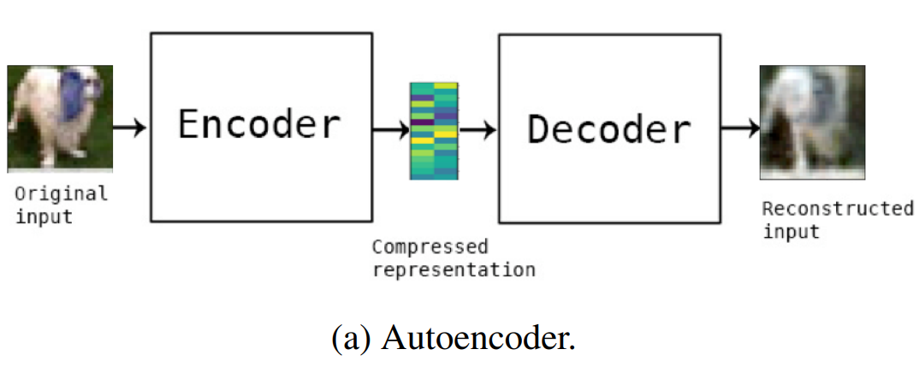
Anomaly based
One class Neural Net
Pre-training
AE 학습 후, encoder 딴을 전이학습 하여 AD에 이용
Keras
Implementation
https://github.com/raghavchalapathy/oc-nn

Slide 16
Next step

Slide 17
1. FDS in insurance domain
2. study Constructive models
3. study Probabilistic models
4. Oversampling by GAN
…

